Slide 1

INT 300 Internship
Prediction of Chronic kidney Disease using Machine Learning Techniques
First review
Team Members
Sivane sentil( E0121027)
Marreddy Gayatri devi( E0421053)
Project Guide
1. Prof .Shiyamala Gowri

Slide 2
Introduction
Machine learning uses various algorithms for building mathematical models and making predictions using historical data or information.
Machine Learning is the field of study that gives computers the capability to learn without being explicitly programmed.
Currently, it is being used for various tasks such as image recognition, speech recognition, email filtering, Facebook auto-tagging, recommender system, and many more.

Slide 3
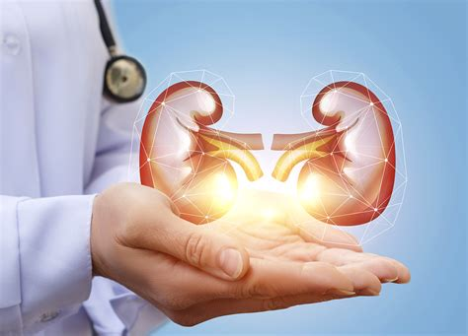
Problem statement
The objective of this project is to check whether the patient is to predict patients with Chronic Kidney Disease using attributes while maintaining a higher accuracy on time.
By using this dataset, we predict whether the patient can have a chronic kidney disease or not. To predict this, we use 25 attributes and 400 rows

Slide 4
Research survey
Datasets | Methodology | Accuracy | Researched by
Chronic kidney disease | Decision tree | 95.92%. | Saurabh Paul
Chronic kidney disease | SVM algorithm | 96.7 % | Siddheshwar Tekale, Pranjal Shingavi
Chronic kidney disease | Logistic regression | 98.8% | Salma Shaji, S R Ajina

Slide 5
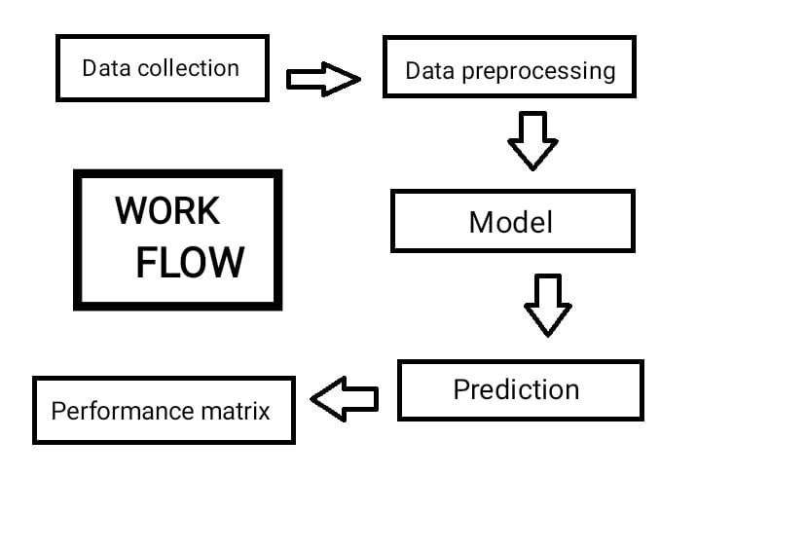
Work Flow/Methodology

Slide 6
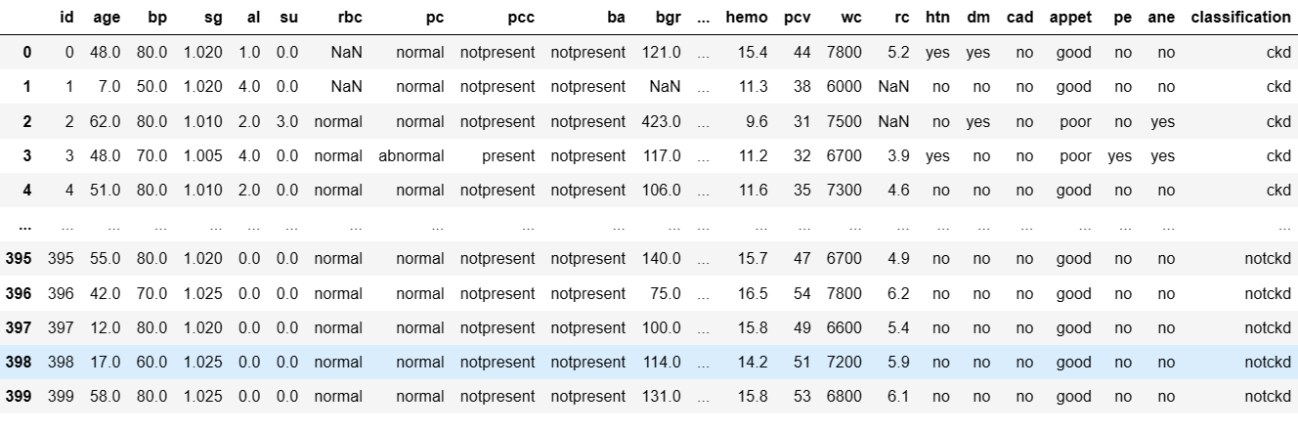
Dataset

Slide 7
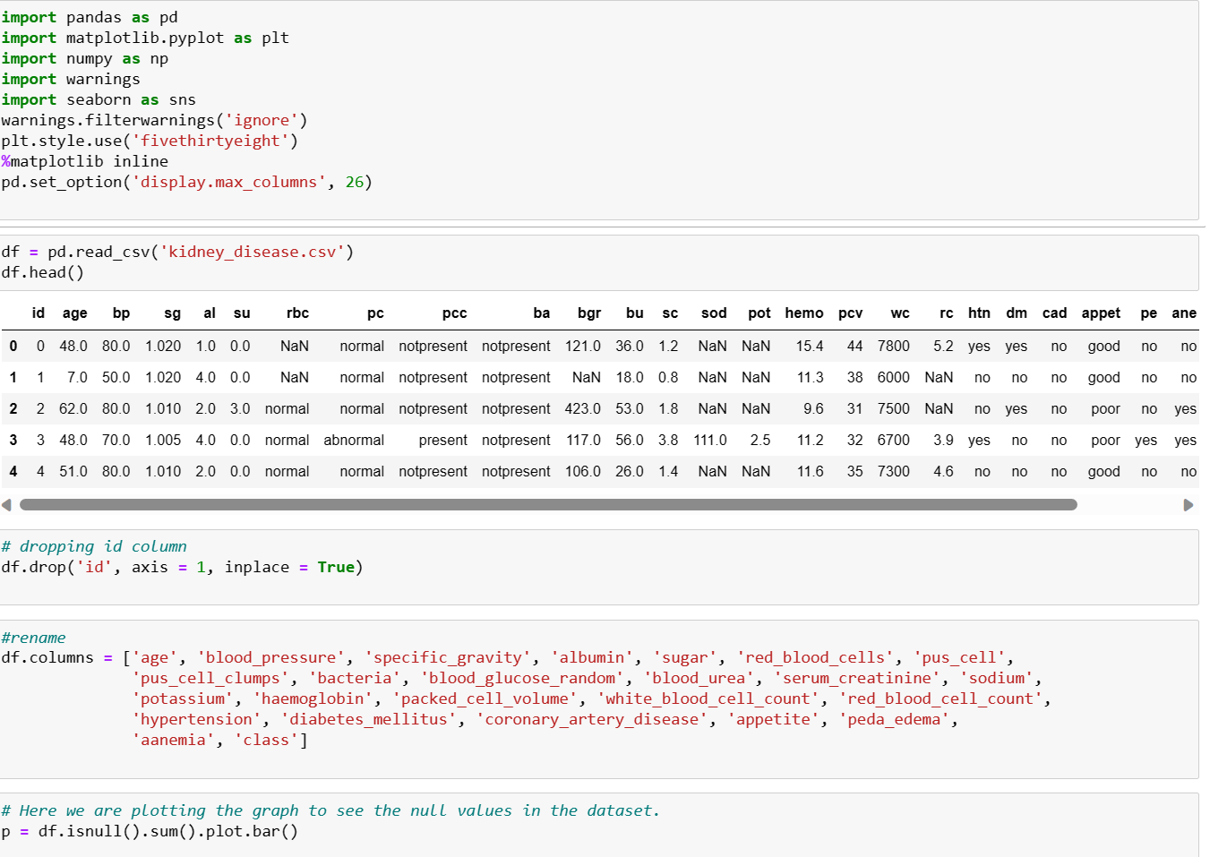
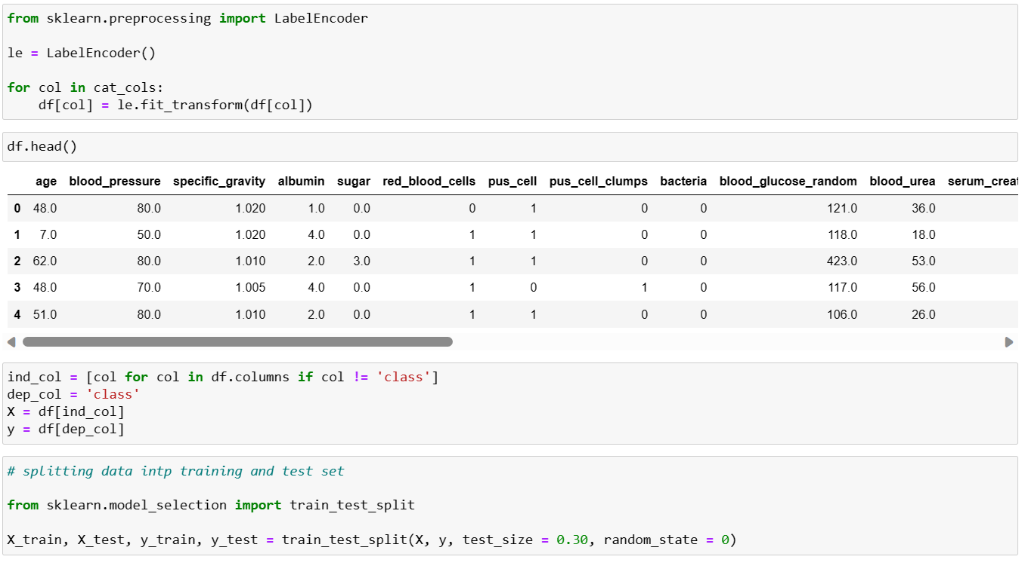
Data preprocessing

Slide 8
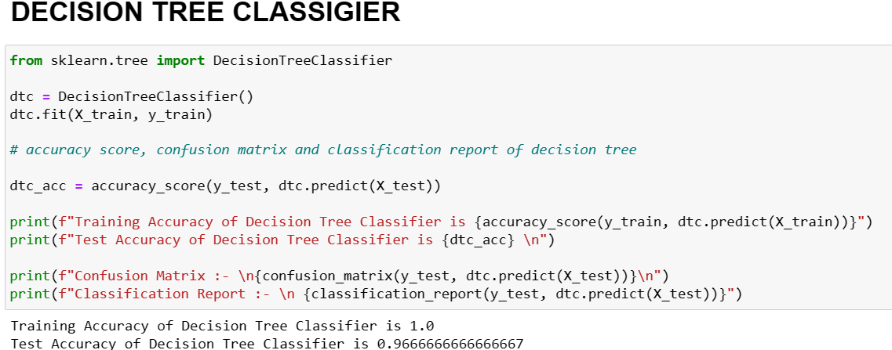
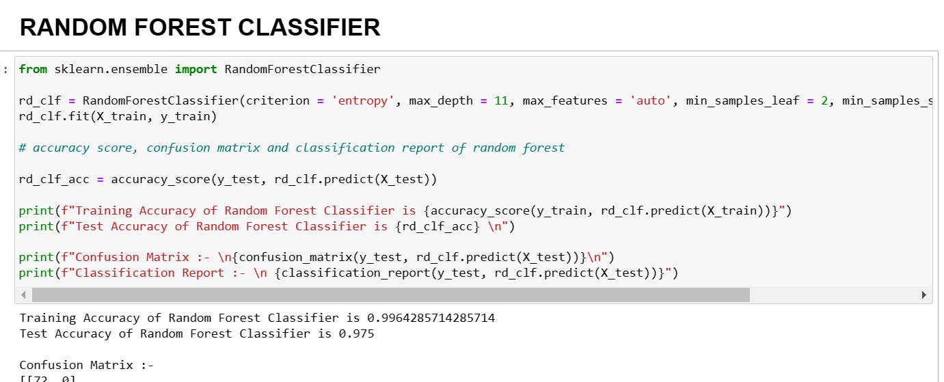
CLASSIFICATION

Slide 9
Timeline of the work
20-02-2023 - 01-03-2023 Learnt Machine Learning from Udemy videos and practised.
02-03-2023 - 06-03-2023 Got the ckd dataset and started working on Data preprocessing.
07-03-2023 - 11-03-2023 Worked on Regression.
12-03-2023 - 16-03-2023 Worked on Classification

Slide 10
CONCLUSION
In classification decision tree classification has the highest accuracy compared to all other algorithms
In data pre-processing we removed all nan values

Slide 11
Reference
https://journalofbigdata.springeropen.com/articles/10.1186/s40537-022-00657-5
https://link.springer.com/article/10.1007/s44174-022-00027-y
https://rn-journal.com/journal-of-nursing/innovation-for-chronic-kidney-disease

Slide 12
Thank you

